Slide 1


Security Camera
Team 6 - ( ͡° ͜ʖ ͡°)

Slide 2
Features
Tracking
Facial Recognition
Face detection
Remote viewing

Slide 3
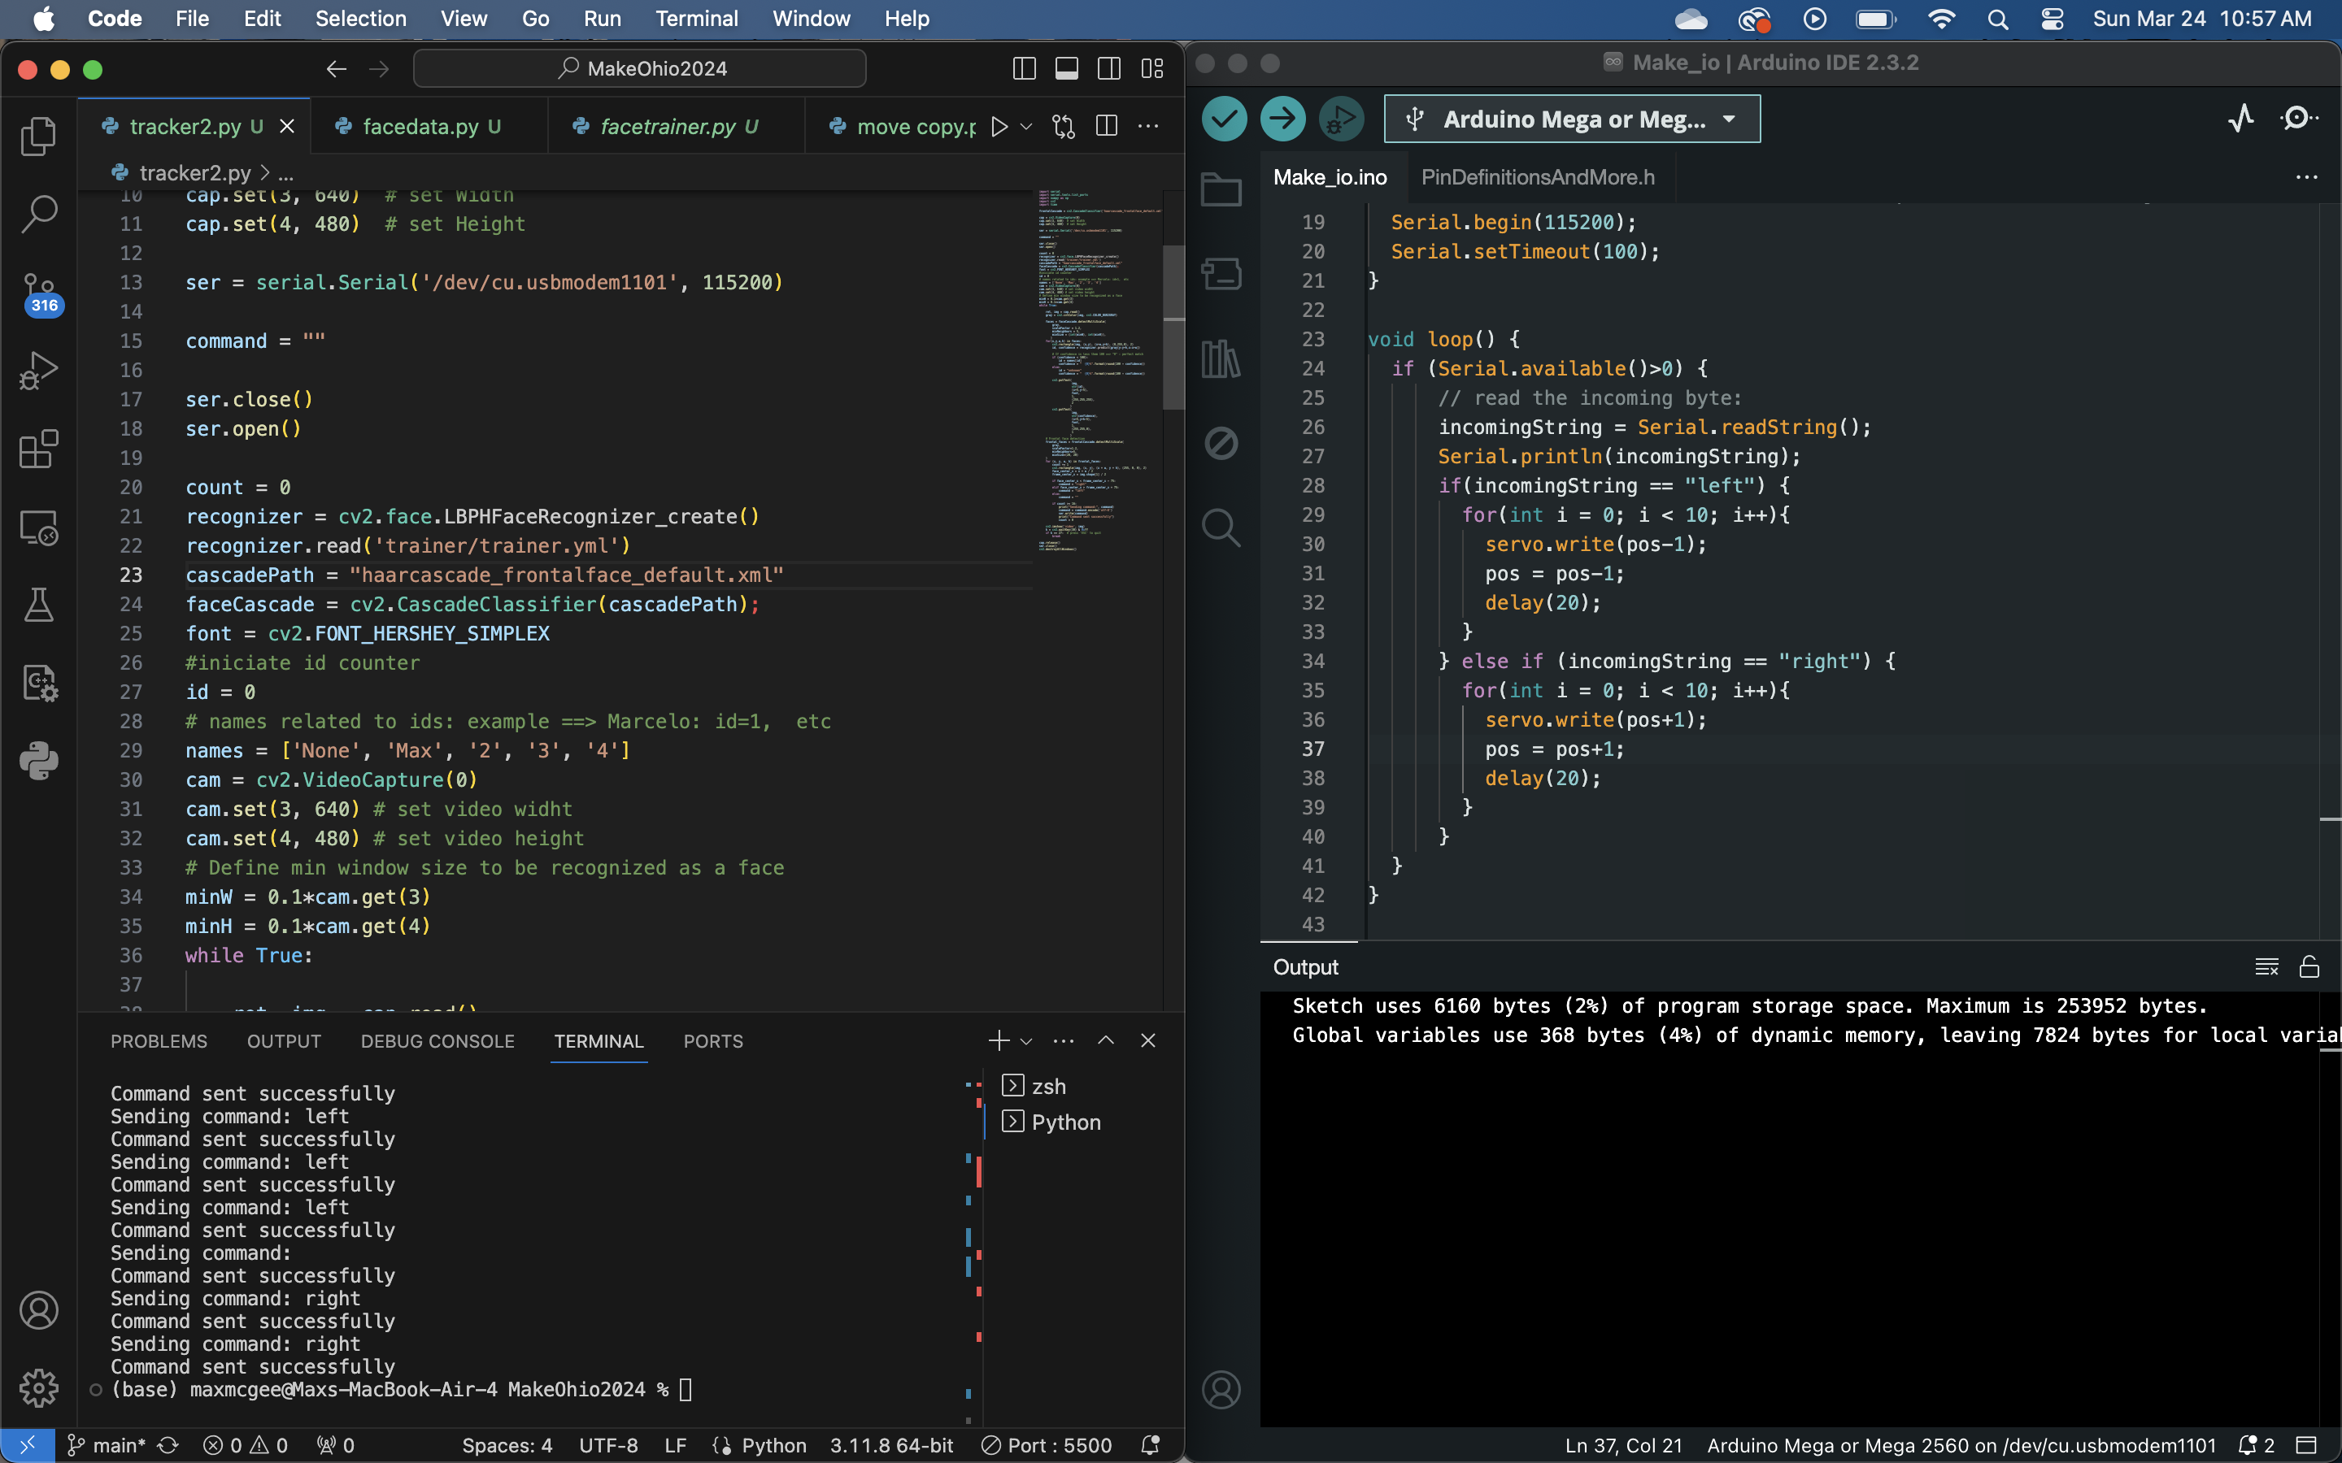
Project code

Slide 4
Impact
Cheaper alternative to other security cameras/systems
Customizable to user needs
Live footage
Upgradeable (could incorporate more cameras)

Slide 5
User Experience
Simple
Customizable

Slide 6
THE END

